Slide 1
CS F372 Operating Systems
20 – Storage Management
Disk structure, Disk Scheduling and RAID

Slide 2
Text Book Reading
Chapter 10
Sections 10.1, 10.2, 10.4, 10.7

Slide 3
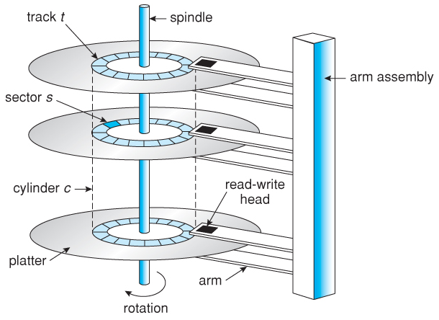
Disk structure
Disks provide the bulk of secondary storage for modern computer systems

Slide 4
Disk structure
Magnetic disks have the following basic structure:
One or more platters in the form of disks
Each platter has two working surfaces
Each working surface is divided into a number of concentric rings called tracks
Each track is further divided into sectors, traditionally containing 512 bytes of data each
The collection of all tracks that are the same distance from the edge of the platter, ( i.e. all tracks immediately above one another) is called a cylinder

Slide 5
Disk structure
The data on a hard drive is read by read-write heads
one head per surface, each on a separate arm and controlled by a common arm assembly which moves all heads simultaneously from one cylinder to another

Slide 6
Disk Scheduling
The operating system is responsible for using hardware efficiently
For the disk drives, this means having a fast access time and large disk bandwidth

Slide 7
Disk Scheduling
Access time has three major components
Seek time is the time for the disk to move the head to the track containing the desired sector
Rotational latency is the additional time for the disk to rotate the desired sector to the disk head
The transfer time, which is the time required to move the data electronically from the disk to the computer
Minimize seek time

Slide 8
Disk scheduling
When a process needs I/O from or to the disk
Issues a system call to the operating system
Whether operation is input or output
What the disk address for the transfer is
What the memory address for the transfer is
What the number of bytes to be transferred is

Slide 9
Disk scheduling
If desired disk drive and controller are available, request serviced immediately.
If drive or controller is busy, request placed in the queue of pending requests
When one request is completed OS chooses which pending request to service next
How does the operating system make this choice?
Disk scheduling algorithms

Slide 10
Disk Scheduling
The process of arranging the order in which read/write operations are carried out on a computer's hard disk
Several algorithms exist to schedule the servicing of disk I/O requests
Consider, for example, a disk queue with requests
for I/O to blocks on cylinders (0-199)
98, 183, 37, 122, 14, 124, 65, 67
Head pointer 53

Slide 11
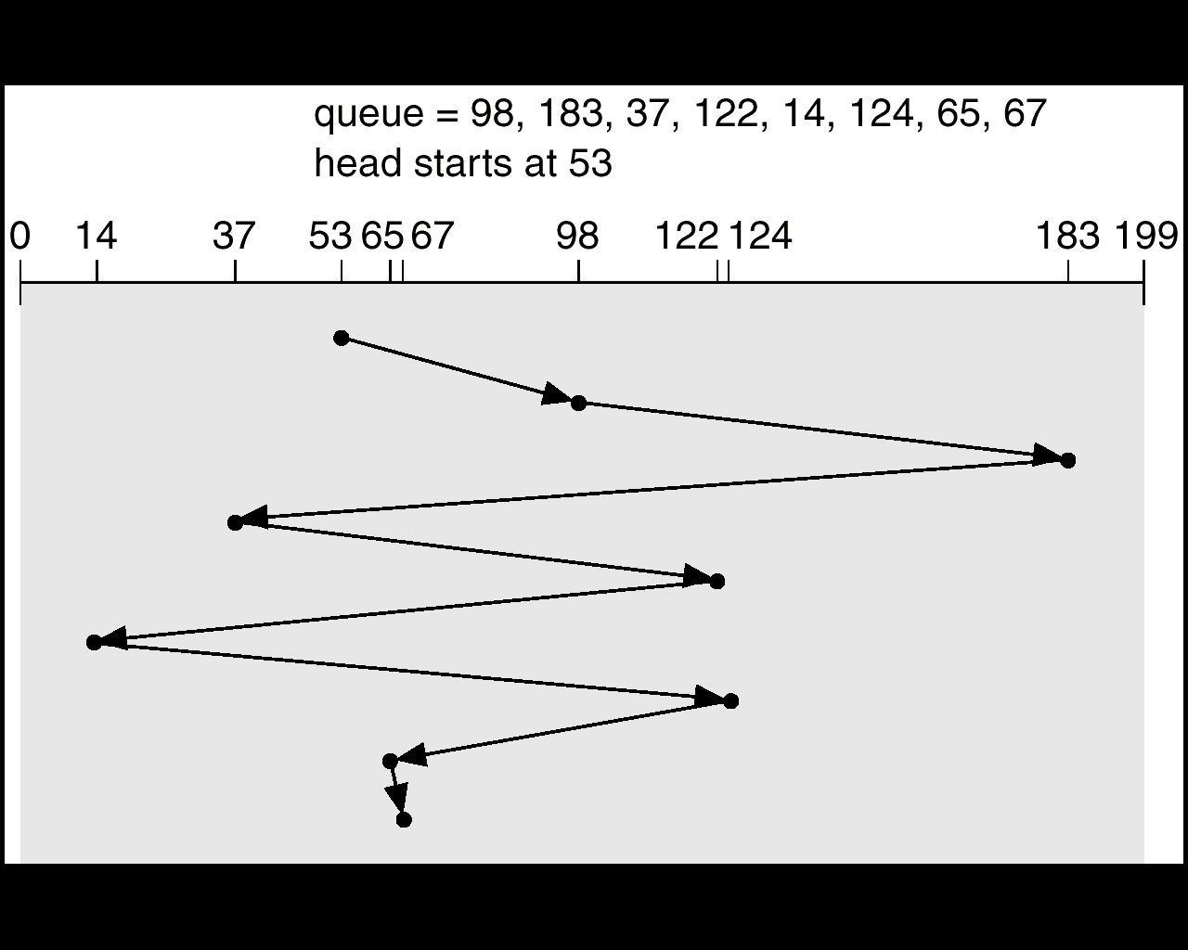
First-Come First-Served (FCFS)
simple and intrinsically fair, but not very efficient
Total head movement of 640 cylinders.

Slide 12
First-Come First-Served (FCFS)
98, 183, 37, 122, 14, 124, 65, 67
|53 – 98| | 45
|98 – 183| | 85
|183 – 37| | 146
|37 – 122| | 85
|122 – 14| | 108
|14 – 124| | 110
|124 – 65| | 59
|65 – 67| | 2
Total = | 640

Slide 13
Shortest-Seek-Time-First (SSTF)
Selects the request with the minimum seek time from the current head position
Chooses the pending request close to the current head position
SSTF scheduling is a form of SJF scheduling
May cause starvation of some requests

Slide 14
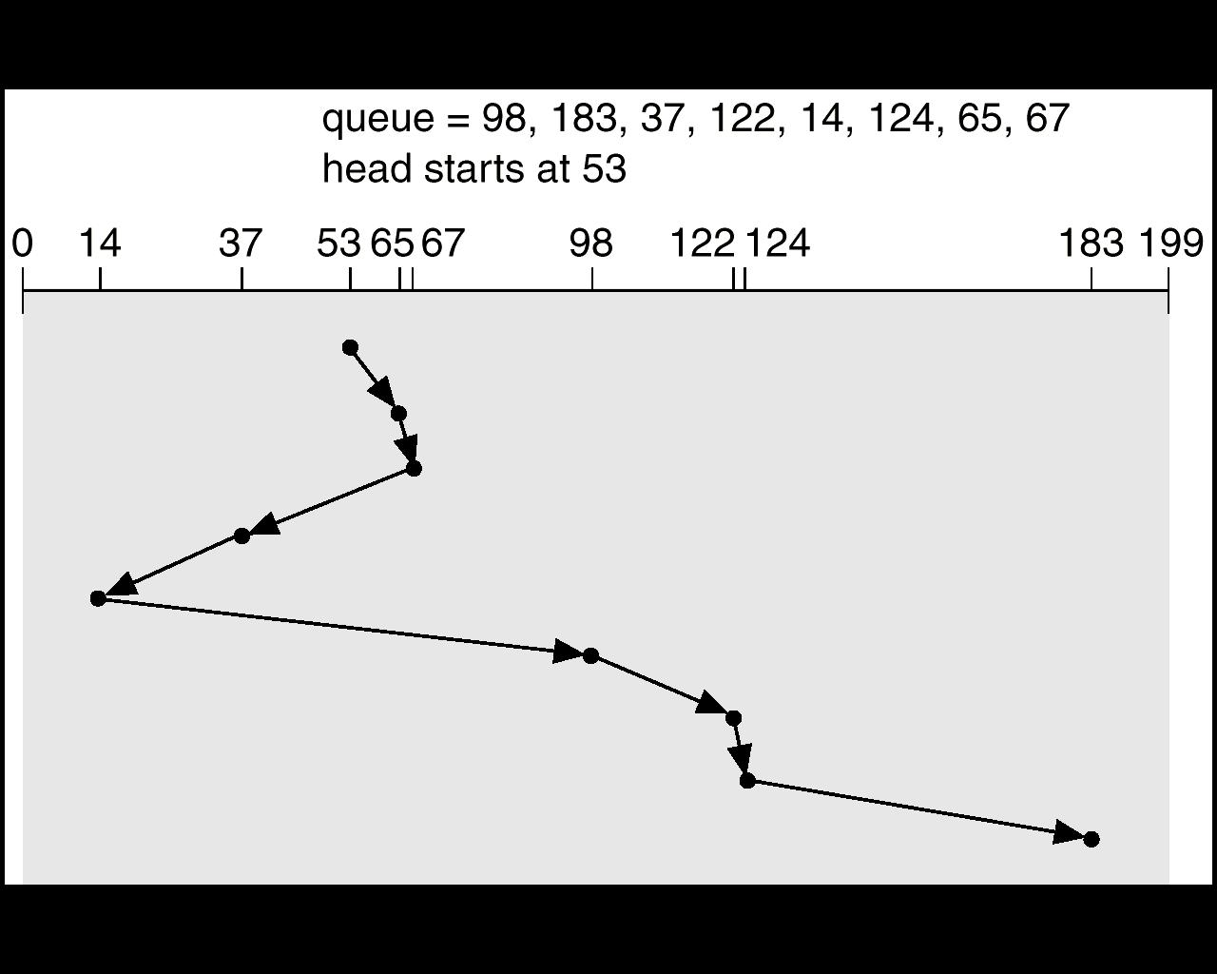
Shortest-Seek-Time-First (SSTF)
Total head movement of 236 cylinders

Slide 15
Shortest-Seek-Time-First (SSTF)
98, 183, 37, 122, 14, 124, 65, 67
Head pointer 53
65 | |53 – 65 | 12
67 | |65-67| | 2
37 | |67 – 37| | 30
14 | |37 – 14| | 23
98 | |14-98| | 84
122 | |98 – 122| | 24
124 | |122 – 124| | 2
183 | |124 – 183| | 59
 | Total = | 236

Slide 16
SCAN/ elevator algorithm
The disk arm starts at one end of the disk, and moves toward the other end, servicing requests until it gets to the other end of the disk
The head movement is then reversed and servicing continue
Sometimes called the elevator algorithm.

Slide 17
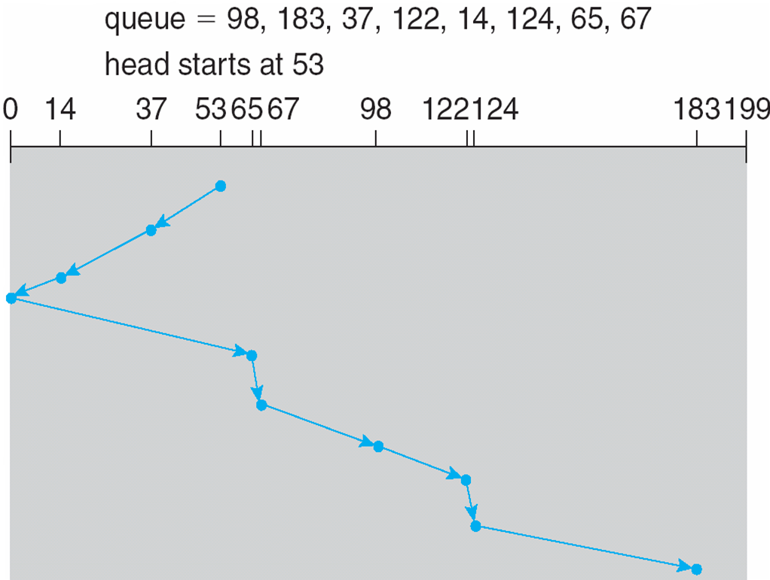
SCAN
Head moves from right to left

Slide 18
SCAN
Head pointer 53
and moves left
98, 183, 37, 122, 14, 124, 65, 67
37 | |53 – 37| | 16
14 | |37-14| | 23
0 | |14-0| | 14
65 | |0-65| | 65
67 | |65-67| | 2
98 | |67-98| | 31
122 | |98-122| | 24
124 | |122– 124| | 2
183 | |124-183| | 59
Total head movements = 236

Slide 19
C-SCAN
Provides a more uniform wait time than SCAN
The head moves from one end (say from 0) of the disk to the other end (max cylinder) servicing requests as it goes
When it reaches the other end, it immediately returns to the beginning of the disk, without servicing any requests on the return trip
Treats the cylinders as a circular list that wraps around from the last cylinder to the first one

Slide 20
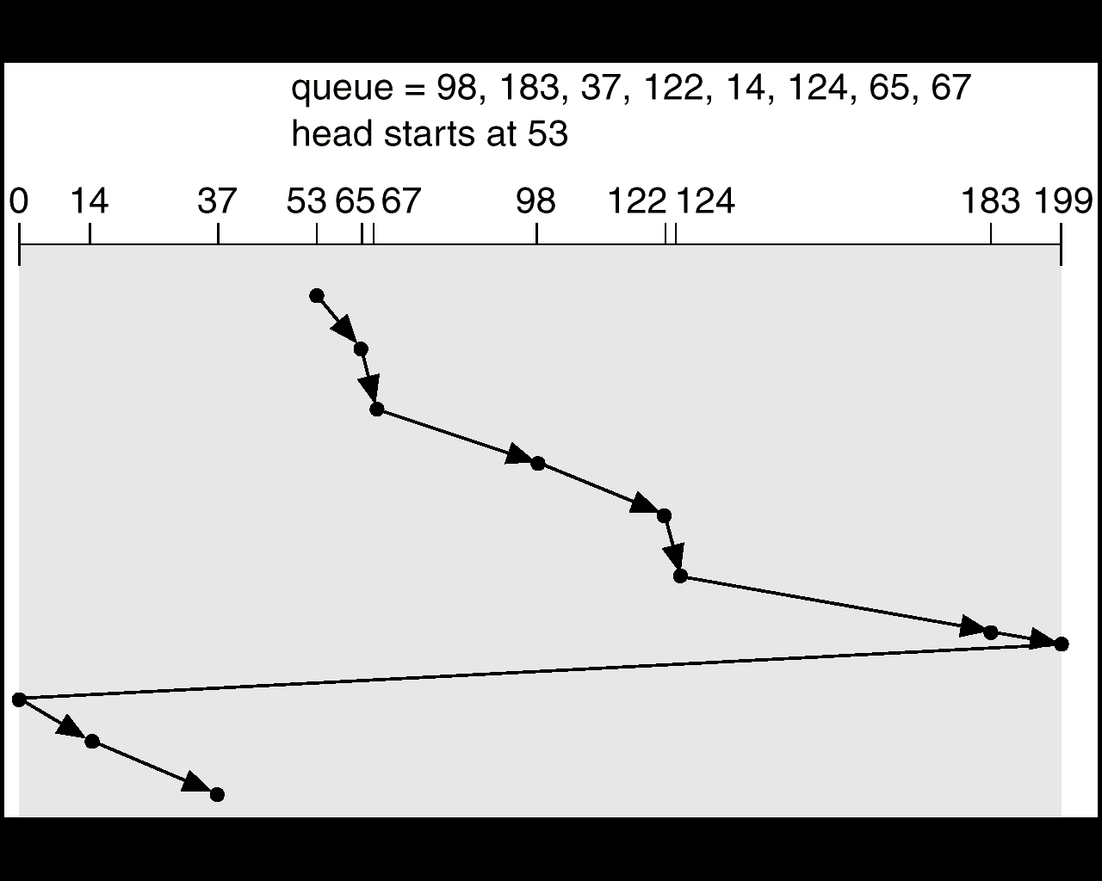
C-SCAN
Head moves from left to right

Slide 21
C-SCAN
98, 183, 37, 122, 14, 124, 65, 67
Head pointer 53
and moves right
65 | |53 – 65| | 12
67 | |65-67| | 2
98 | |67-98| | 31
122 | |98-122| | 24
124 | |122-124| | 2
183 | |124-183| | 59
199 | |183-199| | 16
0 | |199-0| | 199
14 | |0-14| | 14
37 | |14–37| | 23
Total head movements = 382

Slide 22
LOOK
Similar to SCAN
The difference between SCAN and LOOK is the disk arm starts at one end of the disk, and moves towards the other end, servicing requests until it gets to the farthest request at the other end of the disk
The head movement is then reversed and service continues in the similar fashion
Total head movements =

Slide 23
LOOK
Head pointer 53
and moves left
98, 183, 37, 122, 14, 124, 65, 67
65 | |53 – 65| | 12
67 | |65-67| | 2
98 | |67-98| | 31
122 | |98-122| | 24
124 | |122-124| | 2
183 | |124-183| | 59
37 | |183-37| | 146
14 | |14–37| | 23
Total head movements = 299

Slide 24
C-LOOK
Variant of C-SCAN
Arm only goes as far as the last request in each direction, then reverses direction immediately
The arm does not go all the way to the end of the disk

Slide 25
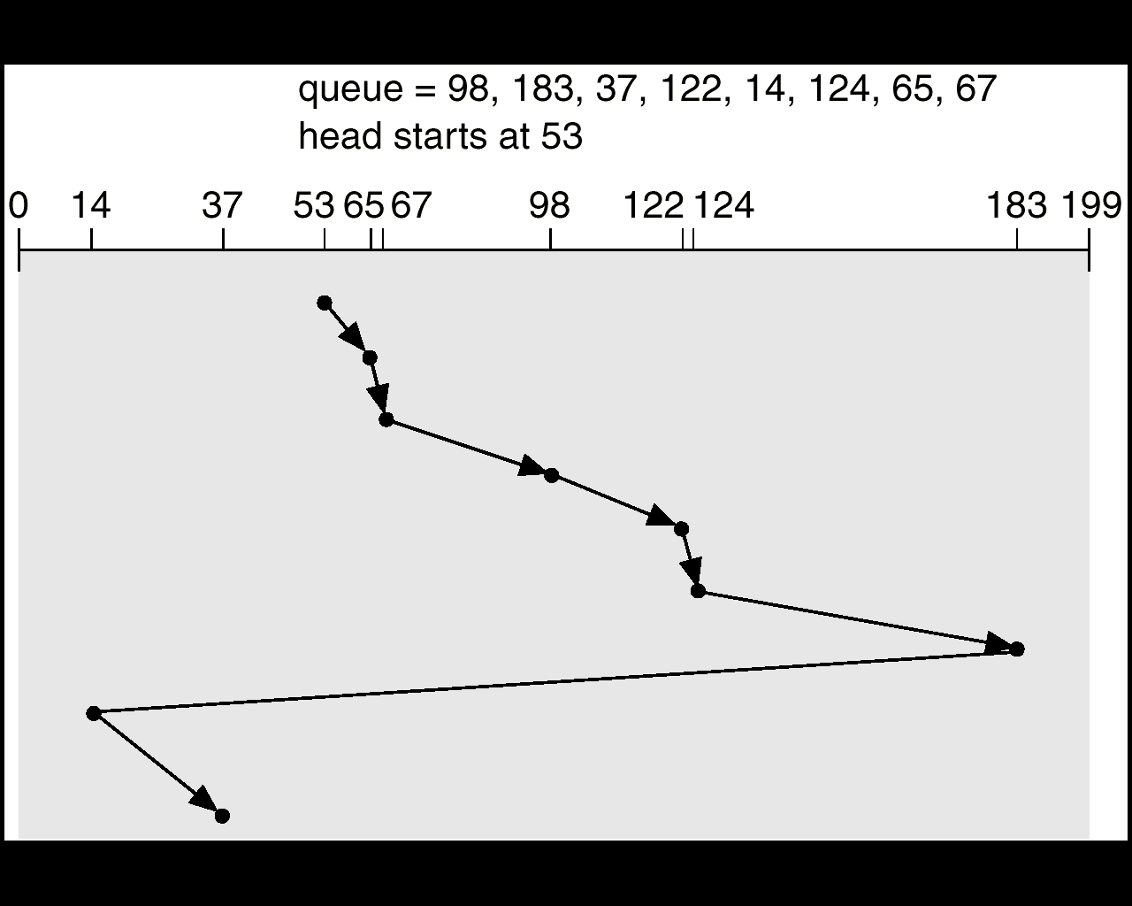
C-LOOK

Slide 26
C-LOOK
Head pointer 53
and moves right
98, 183, 37, 122, 14, 124, 65, 67
65 | |53 – 65| | 12
67 | |65-67| | 2
98 | |67-98| | 31
122 | |98-122| | 24
124 | |122-124| | 2
183 | |124-183| | 59
14 | |183-14| | 169
37 | |14–37| | 23
Total head movements = 322

Slide 27
Selecting a Disk-Scheduling Algorithm
SSTF is common and has a natural appeal because it increases performance over FCFS
SCAN and C-SCAN perform better for systems that place a heavy load on the disk – because less starvation
Performance depends on the number and types of requests.
Say only one outstanding request – all behave like FCFS

Slide 28
Example
Assume a disk with 200 tracks and the disk head is initially at track 100
The disk request queue has the following requests of tracks received by the disk scheduler in order
55, 58, 39, 18, 90, 160, 150, 38, 184
Show how the requests are serviced for each of the scheduling algorithms FIFO, SSTF, SCAN (direction of increasing track nos.), C-SCAN, using a diagram
Also compute the total head movements in each case

Slide 29
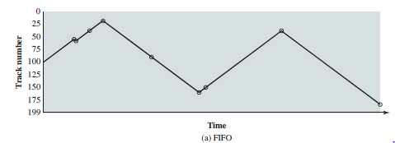
FIFO

Slide 30
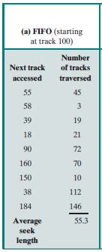
FIFO
Head movements = 498

Slide 31
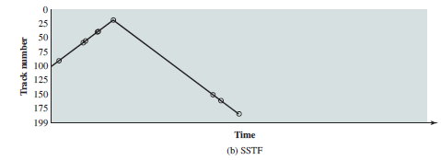
SSTF

Slide 32
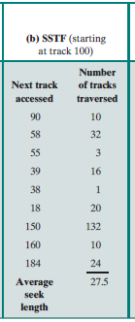
SSTF
Head movements = 248

Slide 33
SCAN & C-SCAN
SCAN Head movements = 280
C- SCAN head movements = 378

Slide 34
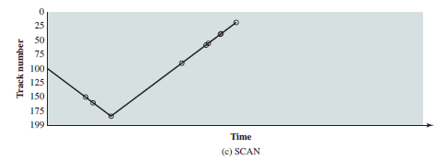
LOOK

Slide 35
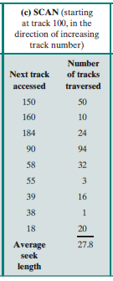
LOOK
Head movements = 250

Slide 36
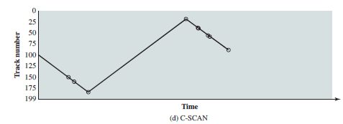
C-LOOK

Slide 37
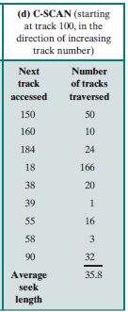
C-LOOK
Head movements = 322

Slide 41
Buddy System of memory allocation
Allocates memory contiguously
Memory is allocated in powers of 2
If the incoming request is not an exact power of 2 it is rounded off to the next highest nearest power of 2
Example request size is 11 KB = 16 KB
From the available memory, a suitable sized block is then allocated to the requesting process
Entire space available is treated as a single block of 2^{U}
If a request of size s such that 2^{U-1} < s <= 2^{U}, entire block is allocated
Otherwise block is split into two equal buddies
Process continues until smallest block greater than or equal to s is generated

Slide 42
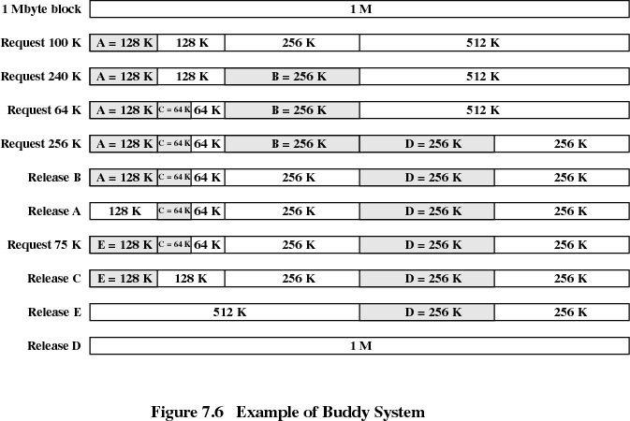

Slide 43
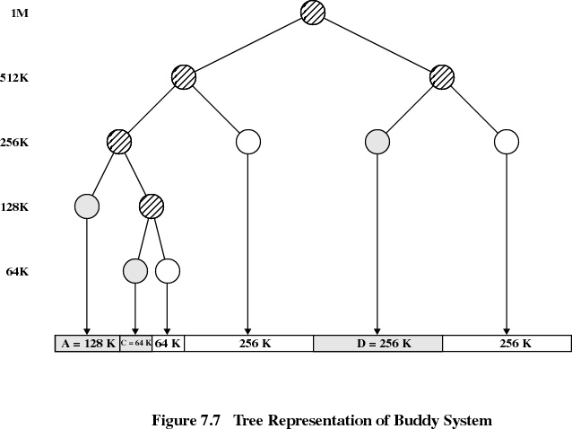

Slide 44
RAID
Redundant arrays of independent/inexpensive disks (RAID) used to address performance and reliability issues
Motivations
Disk bandwidth is very less (80MB/s – 150 MB/s) when compared with the memory bandwidth of CPU
Disk drives are getting cheaper. Can attach many disks to a computer system
Multiple disk drives can provide
Reliability (fault tolerance) via redundancy
Improve performance

Slide 45
Reliability
Each disk has a mean time to failure (MTTF)
the mean time expected until the first failure of a piece of equipment
Chance that one disk will fail out of N disks is higher than the chance that a single disk will fail
Reliability of N disks = reliability of 1 disk / N
Suppose MTTF of a disk is 50,000 hours (6years) then the MTTF of a disk array with 70 disks is
50,000/70= 714 hours = 29 days

Slide 46
RAID – Improvement of Reliability
If only one copy of data is stored, disk failure will result in loss of data
Solution is redundancy
Simplest approach is to duplicate every disk (mirroring)
Store extra information to rebuild the lost information

Slide 47
RAID Level-0 (No Redundancy)
Uses data striping
spread data over multiple disks
Break a file into blocks of data
Stripe the blocks across disks in the system
Multiple I/O can be serviced in parallel
Provides no redundancy or error detection
Less reliable

Slide 48
RAID Level-0
file data
block 0
block 1
block 2
block 3
block 4
0 block 0
1 block 2
2 block 4
3
4
5
0 block 1
1 block 3
2
3
4
5
sectors
sectors
Disk 0
Disk 1

Slide 49
Exploit Parallelism
Example: Consider a big file striped across N disks
stripe width is S bytes
hence each stripe unit is S/N bytes
S
S
S
s_{0,0}
s_{0,1}
s_{0,2}
• • •
s_{0,N-1}
s_{1,0}
s_{1,1}
s_{1,2}
• • •
s_{1,N-1}
s_{2,0}
s_{2,1}
s_{2,2}
• • •
s_{2,N-1}
• • • • •
Disk 0
Disk 1
Disk 2
Disk N-1
S_{0,0}
S_{0,1}
S_{0,2}
• • •
S_{0,N-1}
S_{1,0}
S_{1,1}
S_{1,2}
• • •
S_{1,N-1}
S_{2,0}
S_{2,1}
S_{2,2}
• • •
S_{2,N-1}
• • •
• • •
• • •
• • •

Slide 50
Performance Benefit
read or write of large file
application (or I/O buffer cache) reads in multiples of S bytes
controller performs parallel access of N disks
aggregate bandwidth is N times individual disk bandwidth
Disk 0
Disk 1
Disk 2
Disk N-1
• • •
x MB/s
x MB/s
x MB/s
x MB/s
S _{k,0}
S _{k,1}
S _{k,2}
S _{k,N-1}
Array Controller
Nx MB/s
S_{k}

Slide 51
N concurrent small read or write requests
randomly distributed across N drives (we hope!)
common in database and Web server environments
Disk 0
Disk 1
Disk 2
Disk N-1
• • •
x MB/s
x MB/s
x MB/s
x MB/s
req 1
req 2
req 0
req N-1
Array Controller
Nx MB/s
N independent requests

Slide 52
RAID Level-1
Requires a minimum of 2 disks
Uses Mirroring
A complete file is stored on a single disk
A second disk contains an exact copy of the file
When one disk fails, system uses the mirror disk
Read performance can be improved
file data can be read in parallel
Write performance suffers
must write the data out twice
Most expensive RAID implementation
requires twice as much storage space

Slide 53
RAID Level-1
file data
block 0
block 1
block 2
block 3
block 4
0 block 0
1 block 1
2 block 2
3 block 3
4 block 4
5
0 block 0
1 block 1
2 block 2
3 block 3
4 block 4
5
sectors
sectors

Slide 54
RAID Level-2
Bit-level data striping and ECC
Stripes bits of data across disks
Error Correcting Codes (ECC)
Redundant information, less than the actual data, computed from the data
Monitor correctness of information on disk and helps to identify which disk has failed
Uses Hamming error correction code
Two groups of disks
One group of disks are used to write the data
Another group is used to write the ECC

Slide 55
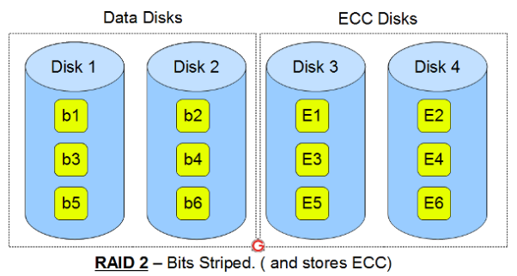
RAID Level-2

Slide 56
RAID Level-2
Data Write
Calculate the ECC code for the data on the fly
Stripe the data bits to the data-disks
Write the ECC code to the redundancy disks
Data Read
Read the corresponding ECC code from the redundancy disks
Check whether the data is consistent
If required, make appropriate corrections on the fly

Slide 57
RAID Level-2
Uses lot of disks
Not used anymore
Expensive and implementing it in a RAID controller is complex
ECC is redundant now-a-days, as the hard disk controllers can monitor the health of disk and figure out if the disk is bad

Slide 58
RAID Level-3
Uses bit level striping and parity
Uses multiple data disks, and a dedicated disk to store parity
If a disk is bad, the disk controller detects it, and use the parity disk to correct it
Each read/write request access all data + parity disk
This is not commonly used

Slide 59
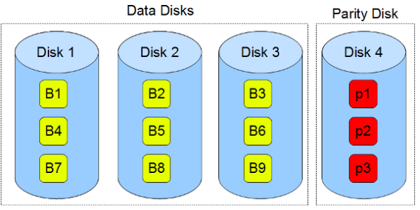
RAID Level-3

Slide 60
RAID Level-4
Problem with Level-2 and Level-3 is the bit interleaving
To access a single block of data, must access all the disks
Level-4 uses
Block level stripping and parity
Uses multiple data disks, and a dedicated disk to store parity
Allows multiple small reads (1 block) to be done at once and in parallel
Small write might require reading other blocks and recomputing and writing the parity

Slide 61
RAID Level-4
Reads are simple to understand
want to read block A, read it from disk 0
if there is an error, read in blocks B, C, D and parity block and calculate correct data
Key problem
parity disk becomes a hot spot
write access to parity disk on every write to any block

Slide 62
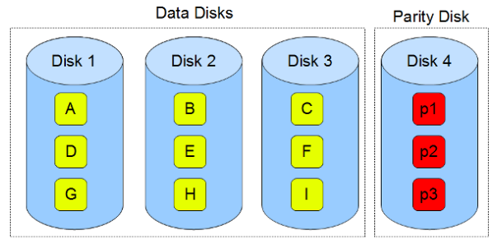
RAID Level-4

Slide 63
RAID Level-5
Block stripping and distributed/rotated parity
Stripes data and parity over all the disks
no longer a single parity disk
Overcomes parity disk bottleneck
Parity update traffic is distributed across disks

Slide 64
RAID Level-5
Level-4
Level-5
check
disk
data disks
data and check disks
1
2
3
4
5
1
2
3
4
5
S₀
S₀
S₁
S₁
S₂
S₂
S₃
S₃
S₄
S₄
S₅
S₅

